Slide 1
Image Segmentation Prof Suresh Pabboju

Slide 2
Outline & Content
Introduction
Thresholding
Edge-based segmentation
Region-based segmentation
conclusion

Slide 3

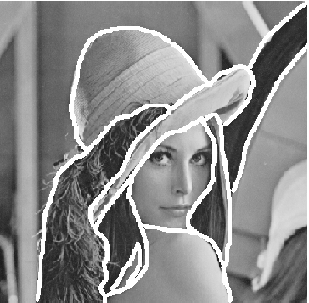
Introduction
What is segmentation?
Three major ways to do.
Thresholding
Edge-based segmentation
Region-based segmentation

Slide 4
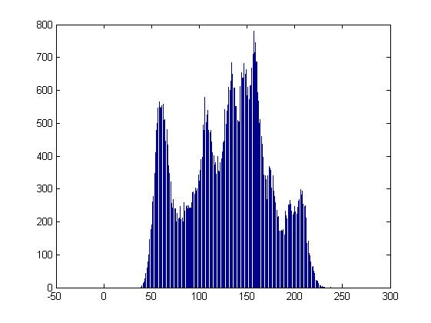
Thresholding
Finding histogram of gray level intensity.
Basic Global Thresholding
Otsu’s Method
Multiple Threshold
Variable Thresholding

Slide 5
Edge-based segmentation
Using mask to detect edge in image by convolution.
Basic Edge Detection
The Marr-Hildreth edge detector(LoG)
Short Response Hilbert Transform(SRHLT)
Watersheds

Slide 6
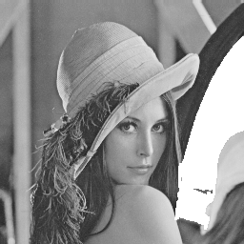
Region-based segmentation
Finding region, but not finding edge.
Region Growing
Data Clustering (Hierarchical clustering)
Partitional Clustering
Cheng-Jin Kuo`s method

Slide 7
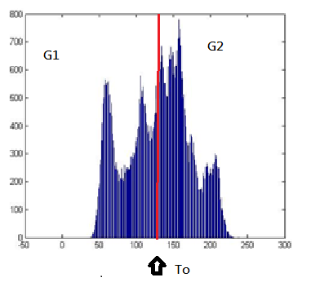
Thresholding Basic Global Thresholding
Select an initial To
Segment image use:
Compute the average intensity
and for the pixels in and .
Compute a new threshold:
Until the difference between values of T is smaller than a predefined parameter.

Slide 8
Otsu’s Method
{0,1,2,…,L-1} , L means gray level intensity
M*N is the total number of pixel.
denote the number of pixels with intensity
we select a threshold , and use it to
classify : intensity in the range and :
,
,
, it is global variance.
Notes:
Optimum Global Thresholding, viewed as a statistical-decision

Slide 9
it is between-class variance
,
it is a measure of separability between class.
For x = 0,1,2,…,M-1 and y = 0,1,2…,N-1.
Using image Smoothing/Edge to improve Global Threshold
 | Smoothing | Edge detection
What situation is more suitable for the method | Large object we are interested. | Small object we are interested
Notes:
Smoothing can make intensity more smooth , on the other way the edge detection can make intensity more clear

Slide 10
Multiple Threshold
As Otsu’s method, it takes more area and k*
Disadvantage: it becomes too complicate when number of area more than three.

Slide 11

Variable Thresholding
Image partitioning
.
It is work when the objects of interest and the background occupy regions of reasonably comparable size. If not , it will fail.
Notes:
It is to subdivide an image into nonoverlapping rectangles

Slide 12
Variable thresholding based on local image properties
Let and denote the standard deviation and mean value of the set of pixels contained in a neighborhood, .
Notes:
這地方為一直掃下來，並算周圍的平均及標準差，再去做分割
3)為一個special case

Slide 13
Using moving average
It discussed is based on computing a moving average along scan lines of an image.
denote the intensity of the point at step k+1.
n denote the number of point used in the average.
is the initial value.
,where b is constant and is the moving average at point (x,y)

Slide 14

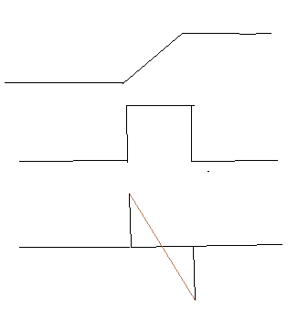
Edge-based segmentation Basic Edge Detection
Why we can find edge by difference?
image
intensity
first-order deviation
second-order deviation
First-order deviation | produce thicker edges
Second-order deviation | stronger response to fine detail | double-edge response | Determine edge is from light to dark or dark to light
Notes:
介紹一階及二階微分

Slide 15
Gradient
The image gradient is to find edge strength and direction at location (x,y) of image.
The magnitude (length) of vector , denoted as M(x,y):
The direction of the gradient vector is given by the angle:

Slide 16
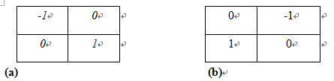
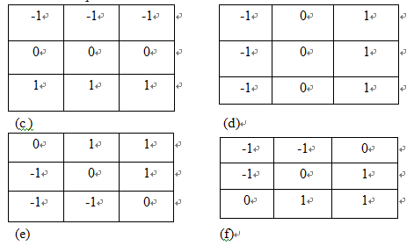
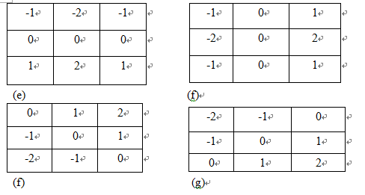
Roberts cross-gradient operators:
Prewitt operator:
Sobel operator:

Slide 17
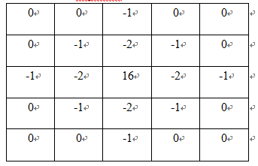
The Marr-Hildreth edge detector(LoG)
This is second-order deviation, we call Laplacian.
Filter the input image with an n*n Gaussian lowpass filter. 99.7% of the volume under a 2-D Gaussian surface lies between about the mean. So .
Notes:
For linear processing

Slide 18
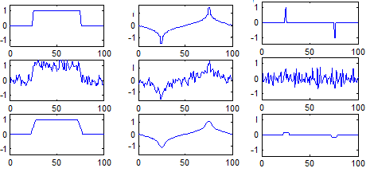
Short Response Hilbert Transform(SRHLT)
Hilbert transform
,
Notes:
The longer impulse response will reduce the sensitivity of the edge detector and at the same time reduce the influence of noise.

Slide 19
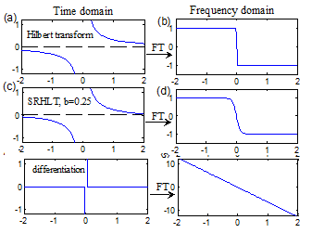
SRHLT
 | Lower b | Higher b
Impulse response | Longer | Shorter
Noise robustness | Good | Bad
Type of edge | Ramp | Step
Output | Thick | Sharp
Notes:
Type of edge is more suitable for ramp or step
Output is width of edge

Slide 20
Simulation result

Slide 21
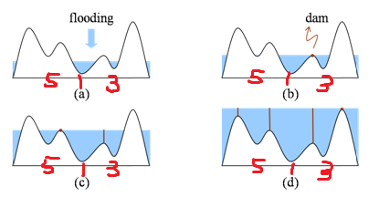
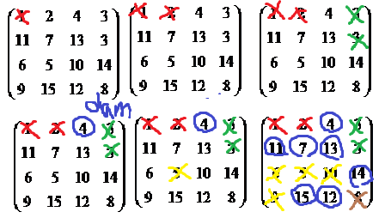
Watersheds
Algorithm:
, g(s,t) is intensity.
n= min+1 to n = max +1. And let T[n]=0, others 1.
, is minimum point beneath n.
Notes:
It is visualizing an image in three dimensions: two spatial coordinates and intensity.
可先大概講概念，再解釋演算法

Slide 22
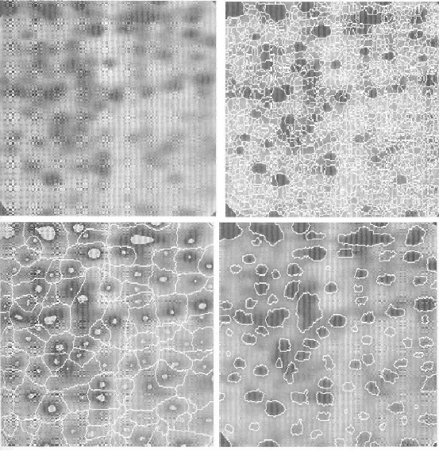
Markers
External markers:
Points along the watershed
line along highest points.
Internal markers:
(1) That is surrounded higher points .
(2) Points in region form a connected component
(3) All points in connected component have the same
intensity.
Notes:
Right-up : gradient , Left-down : smoothing

Slide 23
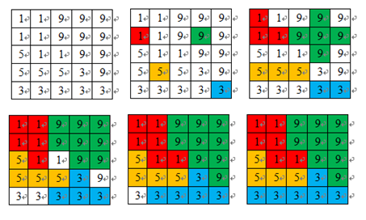
Region-based segmentation Region Growing
Algorithm:
Choose a random pixels
Use 8-connected and threshold to determine
Repeat a and b until almost points are classified.
Notes:
Talk about advantage and disavantage

Slide 24
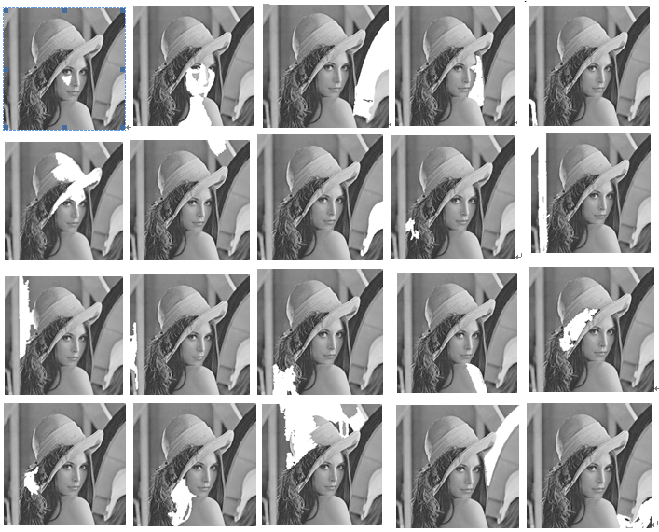
Simulation of region growing (90% pixels )
Threshold/second: 20/4.7 seconds.
Notes:
Talk about advantage and disavantage

Slide 25
Data Clustering
Using centroid to represent the huge numbers of clusters
Hierarchical clustering, we can change the number of cluster anytime during process if we want.
Partitional clustering , we have to decide the number of clustering we need first before we begin the process.
Notes:
可以順便說優缺點

Slide 26
Hierarchical clustering
Algorithm of hierarchical agglomeration(built)：
See every single data as a cluster .
Find out , for the distance is the shortest.
Repeat the steps until satisfies our demand.
as the distance between data a and b
Notes:
凝聚

Slide 27
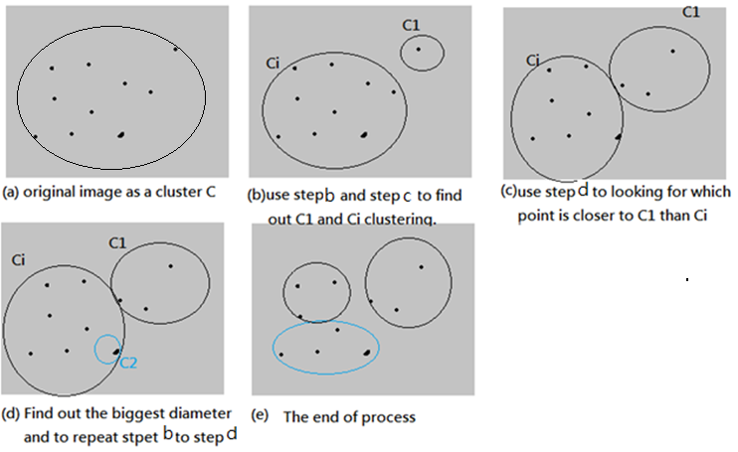
Algorithm of hierarchical division (break up )：
Diameter of cluster
Notes:
解釋為何可以隨時改變cluster 群數

Slide 28
See the whole database as one cluster.
Find out the cluster having the biggest diameter
, .
Split out x as a new cluster , and see the rest data points as .
If > , then split y out of and classify it to
Back to step2 and continue the algorithm until and is not change anymore.

Slide 29
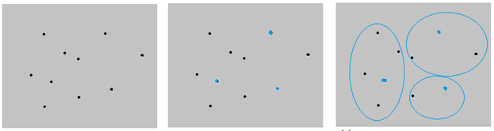
Partitional clustering
Decide the numbers of the cluster(k-means)
Problem:
Initial problem

Slide 30
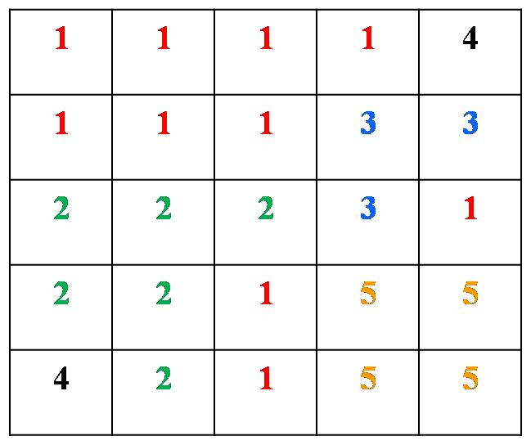
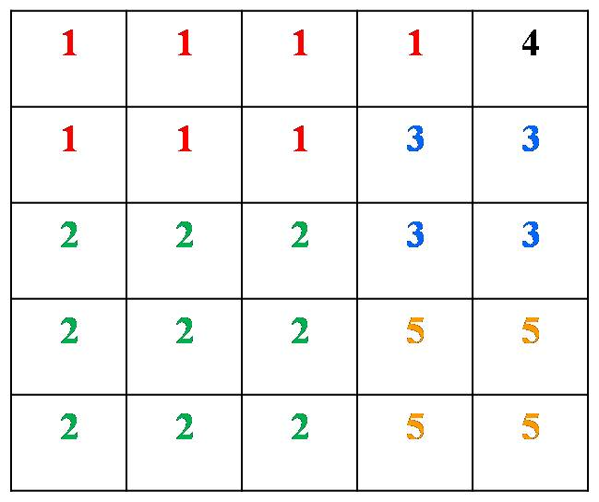
Number of regions are more than clusters you set.
Determine the number of clusters.
Notes:
intra minimize the sum of squared distances from all points to their cluster centers.
inter separate the differences between clusters …. bigger the better. 越大表越分散，故可用較少的點便可分群

Slide 31
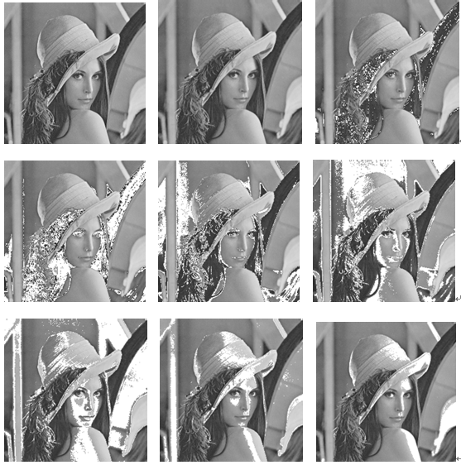
Simulation of k-means
Clustering/time: 9 clustering/ 0.1

Slide 32
Advantage and disadvantage of data clustering
 | Hierarchical algorithm | Partitional algorithms
advantage | 1.Concept is simple 2. Result is reliable. | 1.Computing speed is fast. 2.Numbers of cluster is fixed, so the concept is also simple.
disadvantage | It is consuming, so is not suitable for a large database. | Determine the number of clusters. Initial problem ….

Slide 33
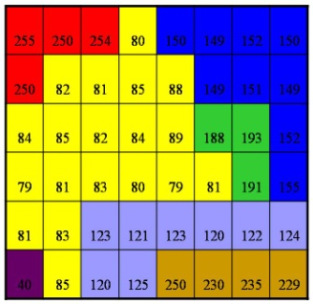
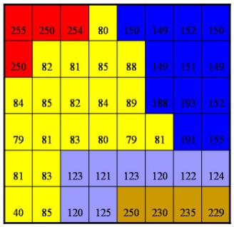
Cheng-Jin Kuo`s method
Algorithm

Slide 34
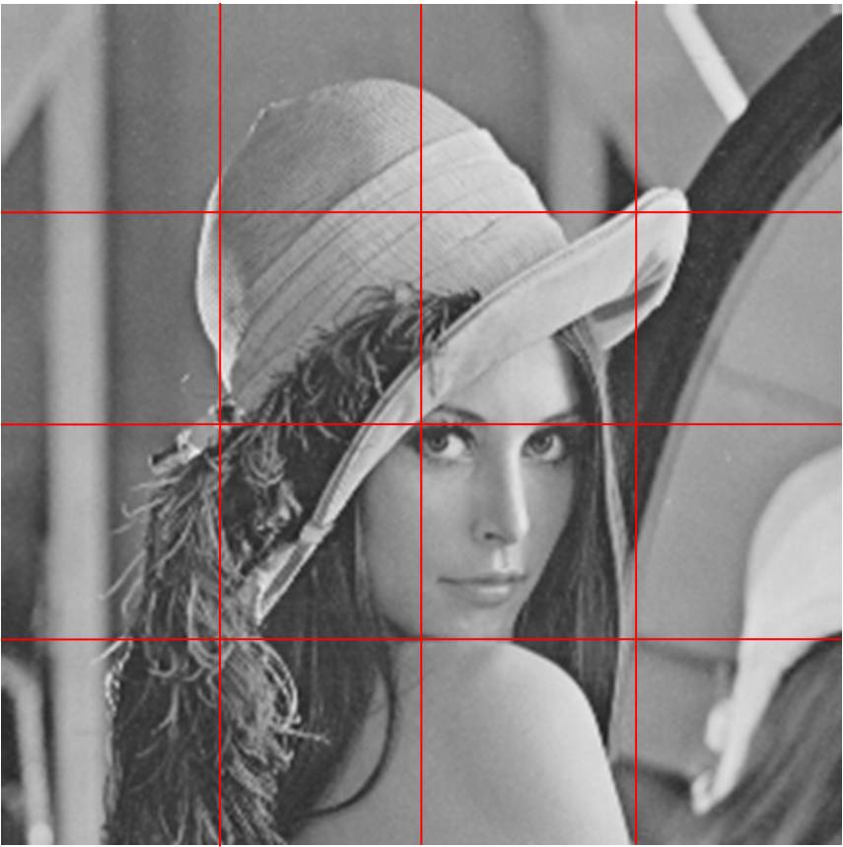
Adaptive threshold decision with local variance
Variance of Lena: 1943
Small variance cause small threshold.

Slide 35
Adaptive threshold decision with local variance and frequency
Variance of baboon: 1503
Notes:
講解high frequency 的原因，並解釋有哪四種狀況。

Slide 36




High frequency, high variance. Set highest threshold.
(4,1)
High frequency, low variance. Set second high threshold.
(4,2)
Low frequency, high variance. Set third high threshold.
(1,4)
Low frequency, low variance. Set the lowest threshold.
(1,1)
Notes:
解釋四種狀況時的threshold

Slide 37
Comparison of all algorithm by data compression
 | Region growing | K-means | Watershed | Cheng-Jin Kuo`s method
Speed | bad | Good(worse than C.J.K’s method) | bad | Good
Shape connectivity | intact | fragmentary | oversegmentation | Intact
Shape match | Good(better than C.J.K’s method) | Good(equal C.J.K’s method) | bad | Good
Notes:
Shape match = system reliability , watershed has oversegmentation , k-means need waste a lot of memory to record the boundaries.

Slide 38
Conclusion
Speed
Connectivity
System reliability
Notes:
順便提一下compression

Slide 39
Reference
R. C. Gonzalez, R. E. Woods, Digital Image Processing third edition, Prentice Hall, 2010.
C. J. Kuo, J. J. Ding, Anew Compression-Oriented Fast image Segmentation Technique, NTU,2009.

Slide 40
Q&A

